Slide 1

TRAIN RESERVATION SYSTEM

Slide 2




Presented by: Batch-89 Group-5 Peethala Rama Lakshmi(Emp Id:6141) Supraja C(Emp id:6142) Anudeep Suragala(Emp id:6148) Niharika Ramesh(Emp id:6151) Pandhi Renuka(Emp id:6167)

Slide 3
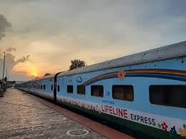
CONTENTS
Introduction
Problem Statement
System design
Technology
Results
Future Enhancement

Slide 4
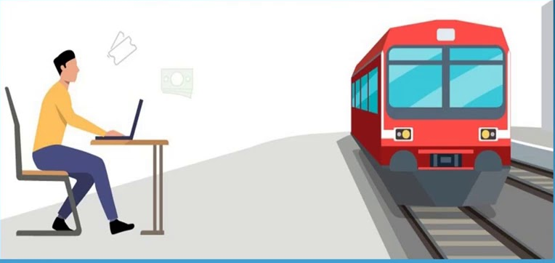
INTRODUCTION
The Train Reservation System facilitates the passengers to enquire about train availability on the basis of Source and Destination and book the ticket
The aim of this project is to design and develop a database maintaining records of different trains and facilitates to book a ticket
It is the computerized system in which the ticket is auto generated that includes all the information regarding the journey of the passenger

Slide 5
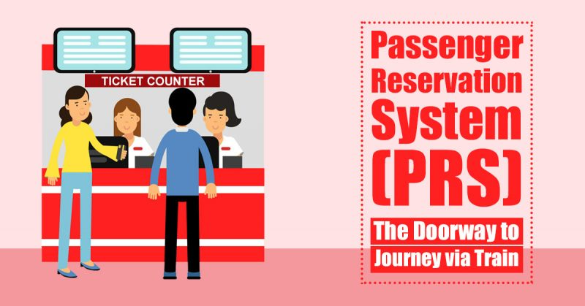
PROBLEM STATEMENT
Customer information centers at the railway stations are unable to serve such queries at peak periods
The number of the reservation counters available to the passengers and customers are very less
On most of the reservation systems there are long queues, so it takes a long time for any individual to book the ticket

Slide 6
SYSTEM DESIGN
Browser
Controller layer
Service layer
Repository/ DOA layer
Database
View
Home
User login
Admin
Admin
Login
Train details
Add Passenger
User
Add Train
Add Ticket
Add passenger
Passenger
Train details
Train tickets
Valid user
Yes
Book ticket
Add/Update information
Payment
Add/Delete/Update
No
Print
Register
Sign out

Slide 7


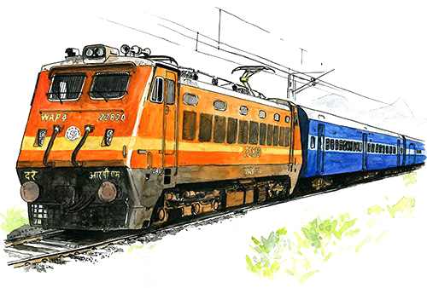



TECHNOLOGIES
Spring boot MVC
Bootstrap
HTML5
CSS3
MYSQL

Slide 8
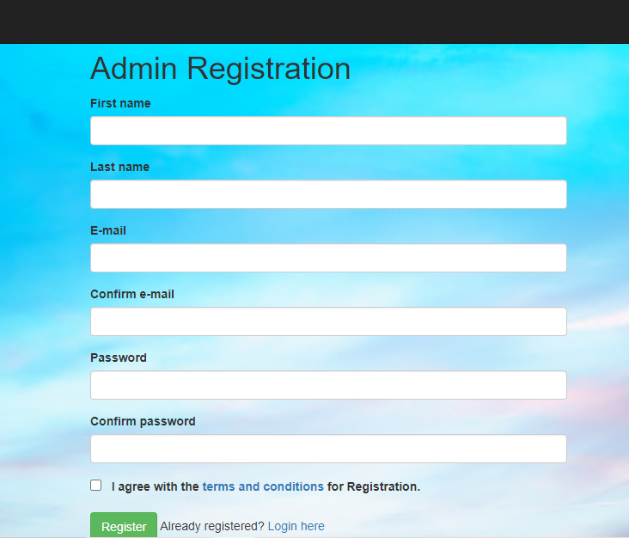
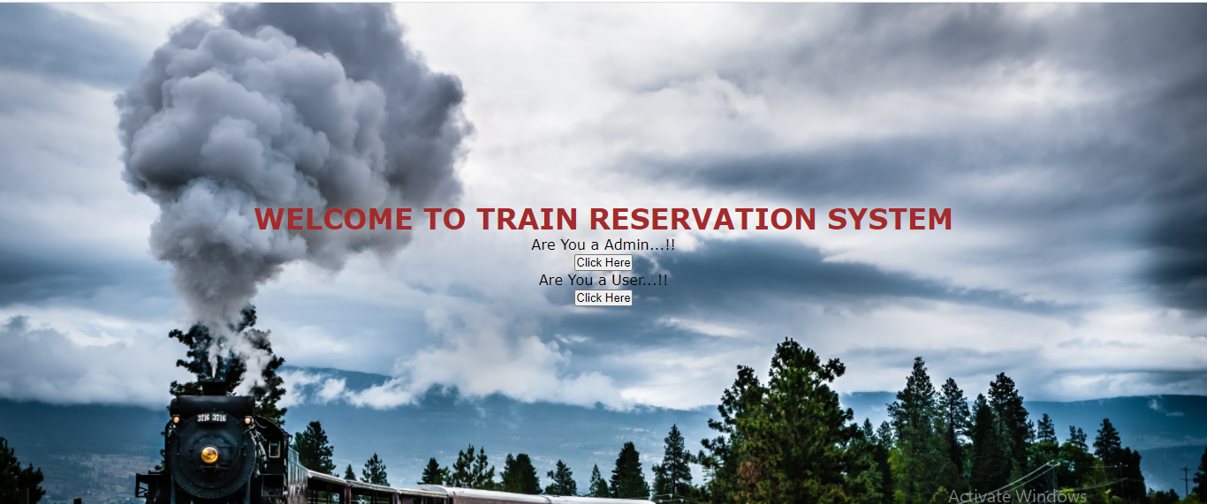
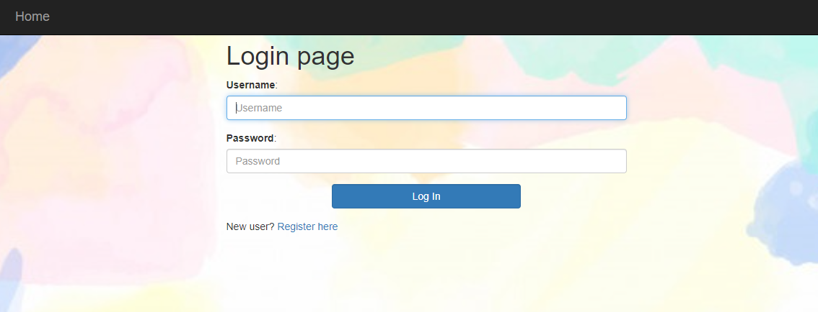
RESULTS
User- Admin Login & Registration

Slide 9
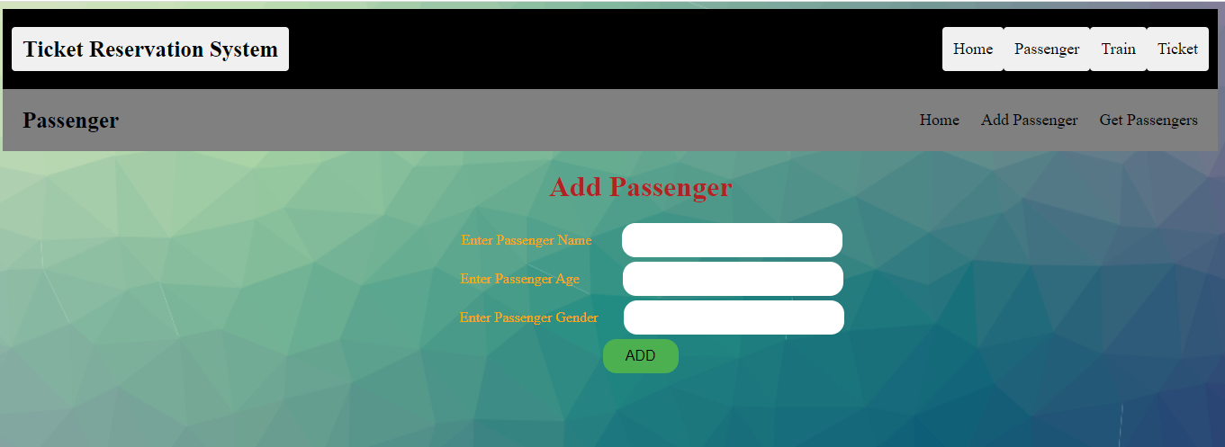
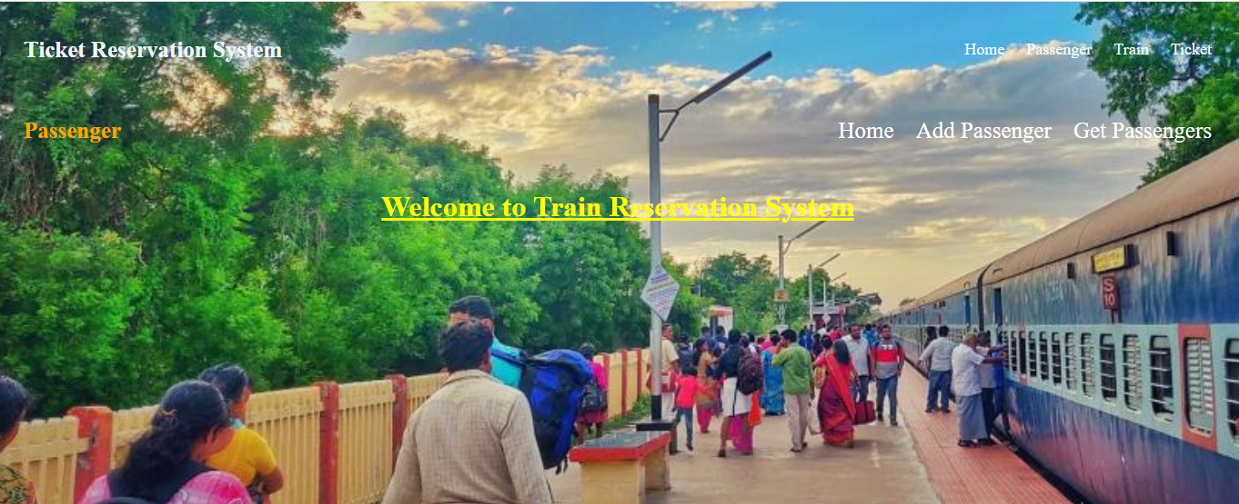
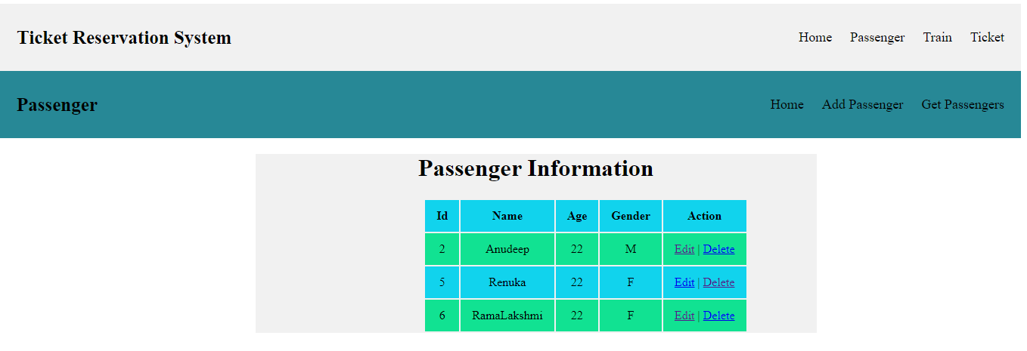
Admin- Edit Passenger

Slide 10
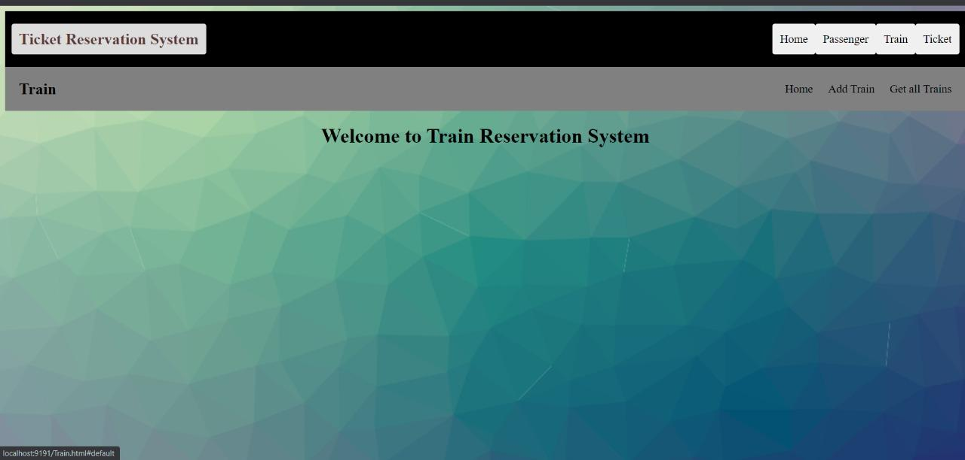
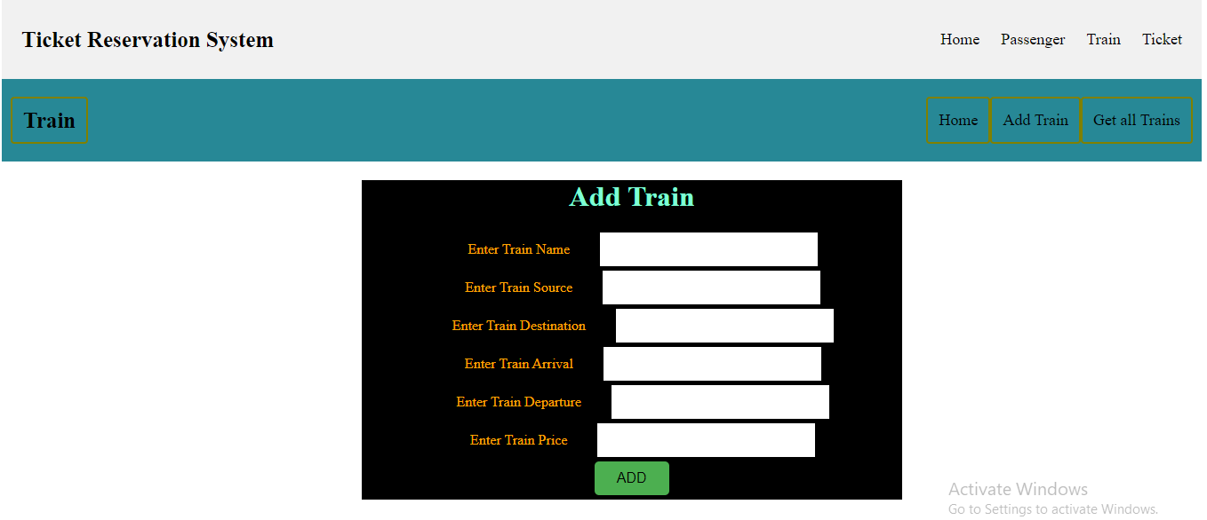
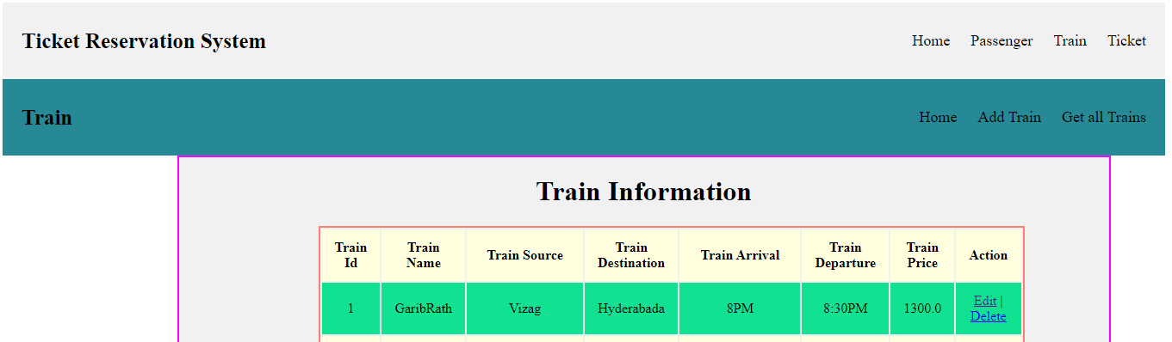
Admin- Edit Train

Slide 11
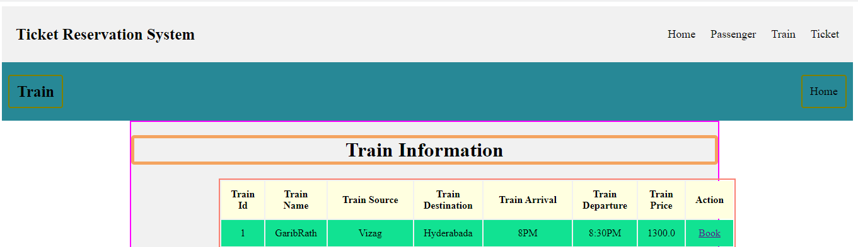
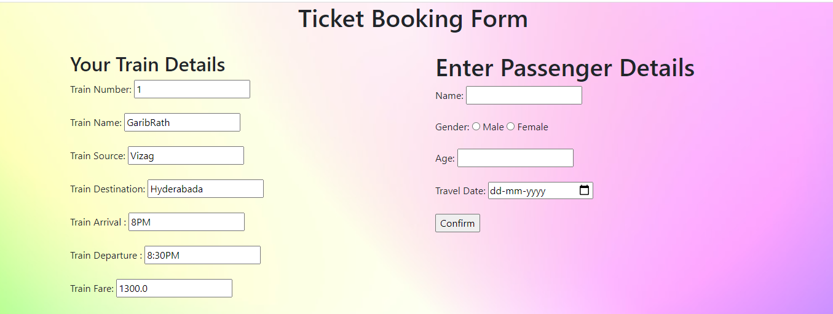
User Perspective

Slide 12
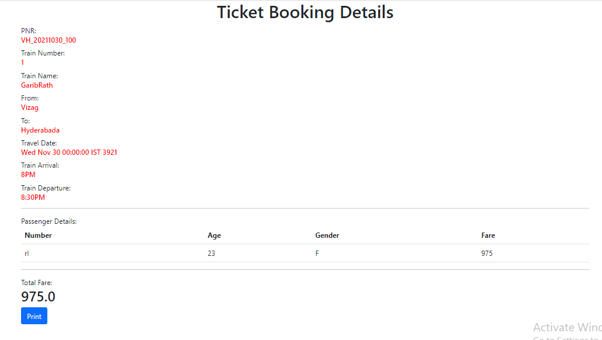
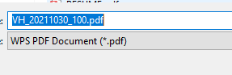
User Perspective-TICKET

Slide 13

FUTURE ENHANCEMENT
The Advanced software of Railway Reservation System can be provided including more facilities and making users to book tickets easily
A database can be added to the check availability of seats which are available after the cancellation of ticket on that specific train.
The platform and routes can be host on online service to
to make accessible to users by creating the accurate databases and security structure in railway reservation
Project can be updated in near future as and when requirement for the same arises, as it is very flexible in terms of expansion.

Slide 14
THANK YOU

